Slide 1
Microsoft Web
platform

Slide 2
What is the Microsoft Web Platform
ASP.NET
EDGE
Apps
Office
AZURE
Notes:
We have a number of webcamps coming up
Looking to get you fully up to speed with ASP.Net web development.
I work for microsoft as a technical evangelist. Day in and day out I’m immersed in the Microsoft world and so often I juwst assume that other developers are as familiar with some of Microsofts technologies as I am. But just so everybody is on the same page I want to briefly talk about these four key foudations. That I will talk a lot about ofver the next hour. Just to make sure that we are all up to speed as to what they are.

Slide 3
Atwood’s Law
Any application that can be written in JavaScript will eventually be written in JavaScript
Jeff Atwood 2007

Slide 4
What is the Microsoft Web Platform
ASP.NET
EDGE
Apps
Office
AZURE
Notes:
We have a number of webcamps coming up
Looking to get you fully up to speed with ASP.Net web development.
I work for microsoft as a technical evangelist. Day in and day out I’m immersed in the Microsoft world and so often I juwst assume that other developers are as familiar with some of Microsofts technologies as I am. But just so everybody is on the same page I want to briefly talk about these four key foudations. That I will talk a lot about ofver the next hour. Just to make sure that we are all up to speed as to what they are.

Slide 5
Presentation (45 mins)
Lab (45 mins)

Slide 6
9:00 - 9:30 | Overview of the Day
9:30 - 10:15 | What's New in ASP.Net 5
10:15 - 11:00 | Build an ASP.NET 5 Site
11:00 - 11:15 | Break
11:15 - 12:00 | What's New in Edge and Visual Studio
12:00 - 12:45 | Lab- Tooling and Edge
12:45-13:30 | Lunch
13:30 - 14:15 | Single Page Applications
14:15-15:00 | Lab - Single Page Applications
15:00-15:15 | Break
15:15-16:00 | Running Web Apps in Azure
16:00-16:45 | Lab- Azure

Slide 7
ASP.NET https://live.asp.net

Slide 8
EDGE Our New Browser

Slide 9
400 million users will UPGRADE FREE to Windows 10 Edge Will be their default

Slide 10
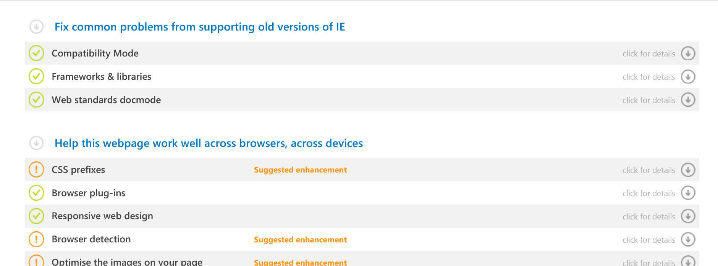
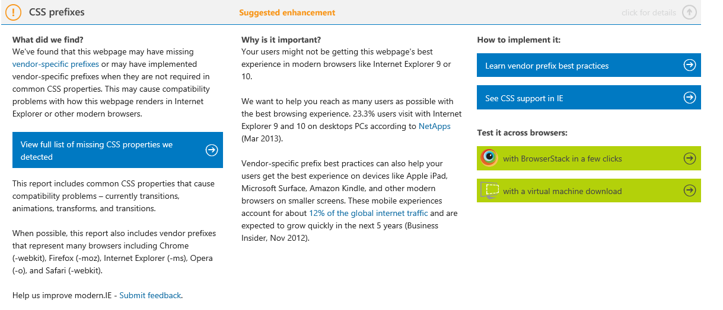
Modern.IE
http://modern.ie
Notes:
Modern.ie allows to do many things, but one of it’s nice features is it’s site scan tool. You can simply enter a URL and have it produce a report listing all of the things you should consider about your website when making it compatible with modern standards. For example in this report were are told that we are using CSS prefixes >>
And when I click on that it gives me information about the problem the scanner found and intructions on how to fix it.

Slide 11
APPS

Slide 12
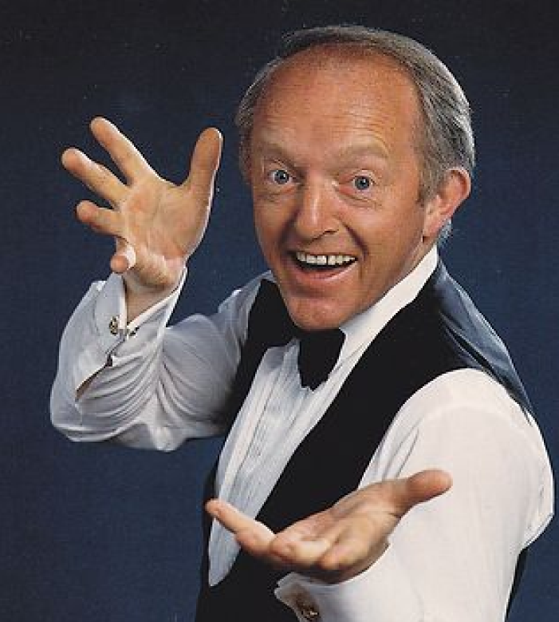



extremely high expectations
Apps are winning
They are satisfying need
The Web can be magical
Notes:
Consumers have really high expectations of software these days. If a website doesn’t load in a few seconds they go elsewhere. If a site doesn't work first time, they go else where. In many instances apps are providing a better experience than website. >>
They are satisfying a need. Delivering beautiful experiences, with touch interfaces that support gestures, that work offline, that work on mobile devices. If you you place that next to an web app that’s been written maybe as year ago. Often the App wins. >>
But the web can be magical >>

Slide 13
Office

Slide 14
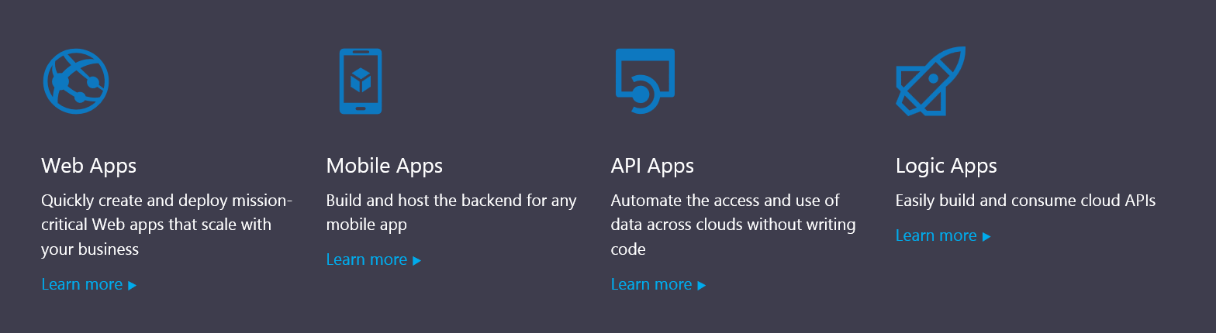
Azure

Slide 15
Who’s in the room?

Slide 16
9:00 - 9:30 | Overview of the Day
9:30 - 10:15 | What's New in ASP.Net 5
10:15 - 11:00 | Build an ASP.NET 5 Site
11:00 - 11:15 | Break
11:15 - 12:00 | What's New in Edge and Visual Studio
12:00 - 12:45 | Lab- Tooling and Edge
12:45-13:30 | Lunch
13:30 - 14:15 | Single Page Applications
14:15-15:00 | Lab - Single Page Applications
15:00-15:15 | Break
15:15-16:00 | Running Web Apps in Azure
16:00-16:45 | Lab- Azure

